Slide 1
Advance the Profession
6.01 Help create an environment supporting ethical conduct
6.02 “Promote public knowledge of software engineering”
6.03 Participate in professional activities
6.04 Support others who are trying to follow this Code
6.05 Do not promote self-interest at expense of profession, client, or employer
6.06 Obey all laws unless there is an overriding public interest
6.07 Do not deceive others regarding the characteristics of software
1-1

Slide 2
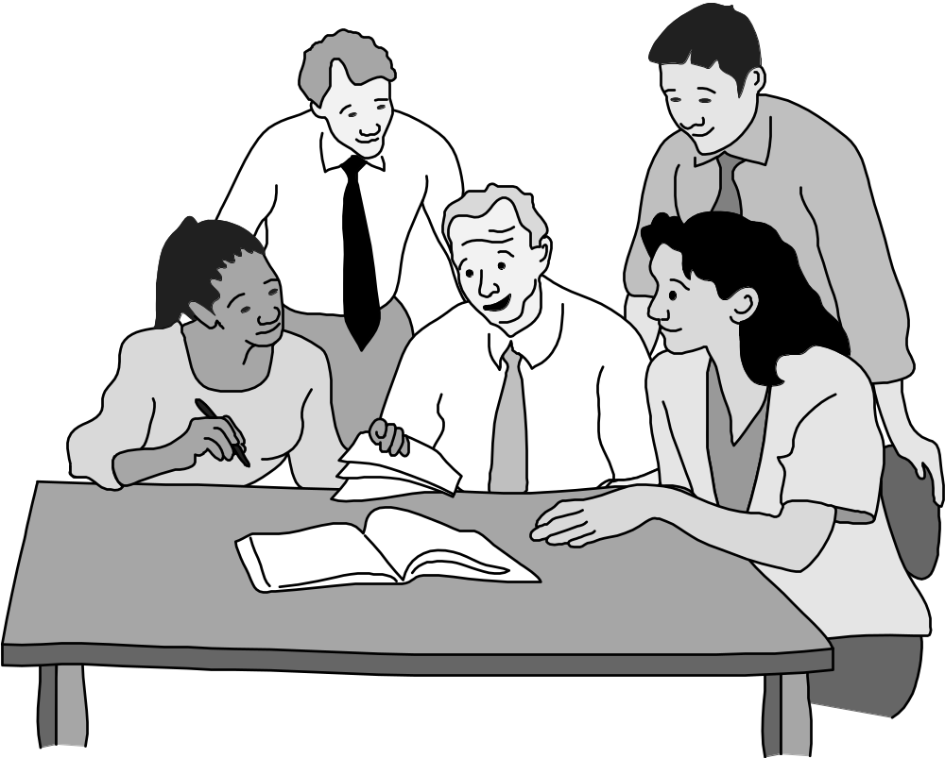
Clause 6.01 Help Create An Environment Supporting Ethical Conduct
1-<number>

Slide 3
Advance the Profession
6.08 Take responsibility for finding, correcting, and reporting errors in software and documentation
6.09 Ensure others know you are committed to the Code and what that means
6.10 Do not associate with businesses and organizations that are in conflict with Code
6.11 Understand violating the Code is inconsistent with being a professional
6.12 Share concerns about Code violations with the people involved
6.13 “Blow the whistle” when no alternative to reporting significant Code violations
1-<number>

Slide 4
Be Fair to and Supportive of Colleagues
7.01 “Encourage colleagues to adhere to this Code”
7.02 “Assist colleagues in professional development”
7.03 Give others the credit they deserve
7.04 Be objective when reviewing the work of others
7.05 Give colleagues a fair hearing
7.06 Help colleagues remain aware of work practices
7.07 Do not unfairly interfere with another’s career, but protect the public interest
7.08 Bring in experts for situations outside your own area of competence.
1-<number>

Slide 5
Participate in Lifelong Learning
8.01 Stay current with developments in field
8.02 Improve ability to create high quality software
8.03 Improve ability to produce high quality documentation
8.04 Improve understanding of software and documentation used in work
8.05 Improve knowledge of relevant standards
8.06 Improve knowledge of this Code and its application
8.07 Do not treat others unfairly because of prejudices
8.08 Do not influence others to break the Code
8.09 “Recognize that personal violations of this Code are inconsistent with being a professional software engineer”
1-<number>

Slide 6

Clause 8.02 Improve Ability to Create High Quality Software
1-<number>

Slide 7
9.4 Analysis of the Code
1-<number>

Slide 8
Analysis of Preamble
No mechanical process for determining if an action is right or wrong
Should not take an overly legalistic view of the Code
  If Code doesn’t forbid something, that doesn’t mean it is morally acceptable
  Judgment required
Code reflects principles drawn from multiple ethical theories
1-<number>

Slide 9
Alternative, Discipline-Independent List of Fundamental Principles
Be impartial.
Disclose information that others ought to know.
Respect the rights of others.
Treat others justly.
Take responsibility for your actions and inactions.
Take responsibility for the actions of those you supervise.
Maintain your integrity.
Continually improve your abilities.
Share your knowledge, expertise, and values.
1-<number>

Slide 10
9.5 Case Studies
1-<number>

Slide 11
Case: Software Recommendation
Sam Shaw asks for free advice on LAN security
Prof. Smith answers questions and recommends top-ranked package
Prof. Smith does not disclose
  She has financial interest in company producing top-ranked package
  Another package was given a “best buy” rating
Did Prof. Smith do anything wrong?
1-<number>

Slide 12
Analysis
Most relevant principles
  Be impartial.
  Disclose information others ought to know.
  Share your knowledge, expertise, and values.
Clause 1.06: Prof. Smith was deceptive
Clauses 1.08, 6.02: Prof. Smith freely gave valuable information
Clauses 4.05, 6.05: Prof. Smith did not reveal conflict of interest
1-<number>

Slide 13
Conclusion
Professor Smith should have revealed her conflict of interest to Mr. Shaw.
1-<number>

Slide 14
Case: Child Pornography
Joe Green a system administrator
Asked to install new software package on Chuck Dennis’s computer
Green not authorized to read other people’s emails or personal files
Green sees suspicious-looking file names
He opens some of Dennis’s files and discovers child pornography
What should he do?
1-<number>

Slide 15
Analysis (1/2)
Most relevant principles
  Be impartial
  Respect the rights of others
  Treat others justly
  Maintain your integrity
1-<number>

Slide 16
Analysis (2/2)
Most relevant clauses
  2.03: Somebody has misused the company PC
  2.09: Someone is using the PC for a purpose not in the employer’s interest
  3.13: Joe violated the policy against opening files
  5.10: Someone else may have planted the files on Chuck’s computer
1-<number>

Slide 17
Conclusions
Joe was wrong to violate company policy to uncover child pornography
Once he has this knowledge, however, he is obliged to share it with company authorities
Joe should be discreet
1-<number>

Slide 18
Case: Anti-Worm
Internet plagued by new worm that exploits hole in popular operating system
Tim Smart creates anti-worm that exploits same security hole
Tim’s anti-worm fixes PCs it infects. It also uses these PCs as launch pad to reach new PCs.
Tim launches anti-worm, taking pains to keep it from being traced back to him.
The anti-worm quickly spreads through Internet, infecting millions of computers
System administrators around the world combat the anti-worm
1-<number>

Slide 19
Analysis (1/2)
Most relevant principles
  Continually improve your abilities.
  Share your knowledge, expertise, and values.
  Respect the rights of others.
  Take responsibility for your actions and inactions.
1-<number>

Slide 20
Analysis (2/2)
Most relevant clauses:
  1.01: Tim did not accept responsibility for his action.
  1.08: The worm was free, but cost system administrators a lot of time.
  2.03: The anti-worm entered computers without permission of their owners.
  8.01, 8.02, 8.06: Tim improved his knowledge and skills by creating the anti-worm.
1-<number>

Slide 21
Conclusions
Tim’s welfare is less important than the public good
By attempting to hide his identity, Tim refused to accept responsibility for his actions
Tim violated the property rights of the PC owners whose systems were infected by his anti-worm
Tim violated the Code
1-<number>

Slide 22
Case: Consulting Opportunity
Jean works in support organization for Acme Corporation
Many Acme customers downgrading their level of support
East Dakota gives Jean opportunity to run a training class similar to that provided by Acme
Jean tells no one at Acme
Jean develops materials at home on own time
Jean takes paid vacation to teach class
1-<number>

Slide 23
Analysis (1/2)
Most relevant principles
  Be impartial.
  Take responsibility for your actions and inactions.
  Disclose information that others ought to know.
  Maintain your integrity.
  Continually improve your abilities.
1-<number>

Slide 24
Analysis (2/2)
Most relevant clauses
  3.04: Jean was well qualified to develop materials and teach class
  8.04: By creating materials, Jean became even more familiar with Acme’s package and its capabilities
  4.05: Jean didn’t disclose his conflict of interest with his employer
  2.08: Jean deprived himself of “time off” needed to do his best work at Acme
  6.05: Jean put his own interest above that of his employer
1-<number>

Slide 25
Conclusions
Jean did not disclose East Dakota’s offer or his decision to Acme’s management
Acme’s management is likely to question Jean’s loyalty to the company
Jean’s actions were wrong and unwise
1-<number>

Slide 26
9.6 Whistle-blowing
1-<number>

Slide 27
Overview of Whistle-blowing
Whistle-blower
  Tries to report harmful situation through authorized channels
  Rebuffed by organization
  Makes disclosure through unauthorized channels
Whistle-blowers punished for their actions
  Lose job or all chances of advancement
  Financial and emotional hardship
False Claims Act
Whistleblower Protection Act
1-<number>

Slide 28
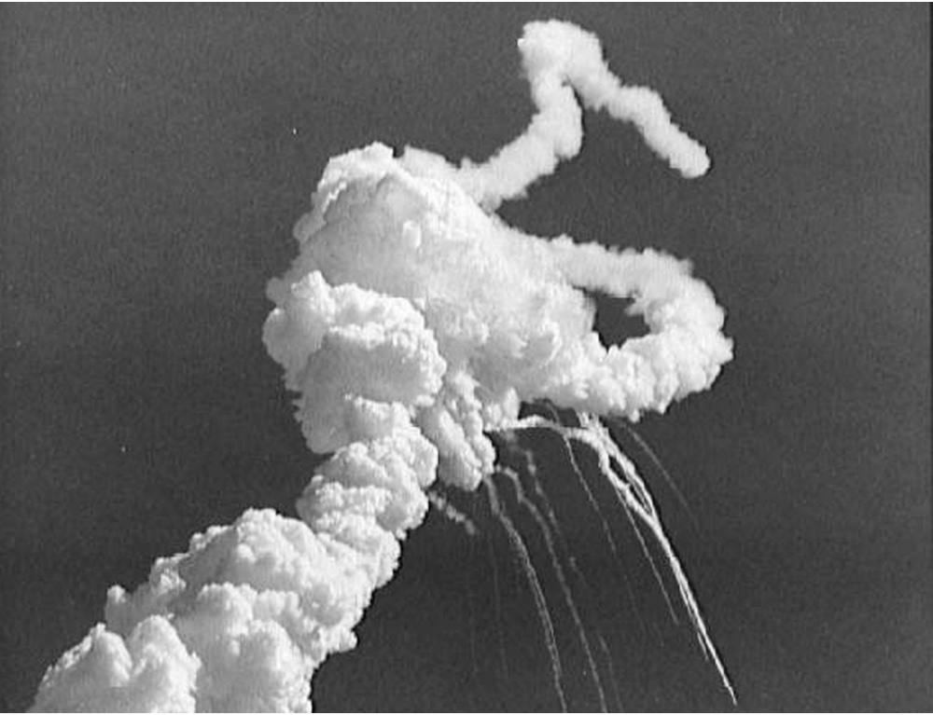
The Challenger Explosion Killed Seven Astronauts
Courtesy of NASA
1-<number>

Slide 29
Case: Morton Thiokol/NASA
Challenger explosion
Roger Boisjoly and Morton Thiokol engineers documented dangers of low-temperature launches
Morton Thiokol executives and NASA officials overrode and hid concerns
Boisjoly shared information with Presidential commission
Morton Thiokol retaliated
  Boisjoly took medical leave for stress, then quit
  Found job as a consultant two years later
1-<number>

Slide 30
Case: Hughes Aircraft
Factory for military-grade hybrid chips
Some defective chips being approved
Ruth Goodearl reported incidents to upper management
Consequences for Goodearl
  Harassed
  Fired
  Unemployment
  Bankruptcy
  Divorce
Goodearl and Ruth Aldred sued Hughes Aircraft under False Claims Act and won
1-<number>

Slide 31
Motives of Whistle-blowers
People become whistle-blowers for different reasons
Morality of action may depend on motives
Good motive
  Desire to help the public
Questionable motives
  Retaliation
  Avoiding punishment
1-<number>

Slide 32
Corporate Response to Whistle-blowing
Whistle-blowers are disloyal
Whistle-blowing has many harms
  Bad publicity
  Disruption of organization’s social fabric
  Makes it hard for people to work as team
If company causes harm, public can use legal remedies to seek damages
Critique: Overly legalistic view of public harm?
1-<number>

Slide 33
Whistle-blowing as Organizational Failure
Whistle-blowing harms organization
  Bad publicity
  Ruined careers
  Erodes team spirit
Whistle-blowing harms whistle-blower
  Retaliation
  Estrangement
Organizations should improve communication
Critique
  Is this realistic?
  Robert Spitzer: Organizations should return to using principle-based ethics in decision making
1-<number>

